Slide 1
Subnational Fertility Projections in Brazil – a Bayesian Probabilistic Approach Application
Gabriel Mendes Borges
IBGE – Brazilian Institute of Geography and Statistics
University of California, Berkeley

Slide 2
Introduction
Population projections in the Brazil, with rare exceptions, have underestimated the fertility decline since the 1970’s
This shows the unexpected velocity of fertility decline in Brazil
Total Fertility Rate (TFR) has reduced from more than 6 children per woman in 1960 to less than 2 in 2010

Slide 3
Objectives
Project TFR for the Brazilian subnational levels using a method that include uncertainty in order to compare the results with the point estimates of deterministic projections released by IBGE (2013)
Run out-of-sample Bayesian probabilistic projections considering the years 1940 to 2000 and then compare the results to the fertility rates estimated for 2010.
Project fertility using the Bayesian probabilistic projections approach from 2010 to 2030 and compare with the estimations published by IBGE (2013).

Slide 4
5 Major Regions
27 Units of Federation (UF)
5,570 municipalities

Slide 5
Data
TFR calculated using the Brass P/F Ratio Method for every decennial Census (1940-2010) – Brazil, Major Regions and UFs
Information for all countries used to perform the Bayesian probabilistic projection derives from the 2012 Revision of the World Population Prospects

Slide 6
IBGE’s 2013 Projection
IBGE only released its first official projections for the UFs using the cohort-component method in 2013.
Method: logistic interpolation of the Total Fertility Rates (TFR) from 2000 to 2010 and an extrapolation of these rates until 2030, considering limits that vary according to the characteristics of each UF.
Intrinsic assumption – fertility will keep falling, and there will be a regional, but not national, convergence in the future.
Notes:
Prior to 2013, IBGE used the “Apportionment Method” to estimate only the total UFs’ population.
It was assumed that there will be a reduction in the difference between the UFs, fallowing the recent trend, but there will not be a complete convergence in the next two decades, due to the expected persistence of cultural differences and socioeconomic inequalities

Slide 7
Total Fertility Rates by Units of Federation – 2000-2030

Slide 8
UN’s Bayesian Probabilistic Projection
Until recently, UN used deterministic approaches to estimate future fertility
Alkema et al. (2011) propose a Bayesian method to produce TFR projections for all countries based on the historic trend of the TRF.
Ševcıková and Gerland (2013) encourage the application of this method also to subnational datasets
The method includes three phases:
the pre-transitional high fertility;
the fertility transition from high to replacement level or below;
the post-transition low fertility, which includes recovery from below-replacement level and oscillations around replacement level.
Notes:
Until recently, UN used deterministic approaches to estimate future fertility, including three scenarios to incorporate uncertainty: medium, high (adding half a child to the TFR) and low (reducing half a child to the TFR).

Slide 9
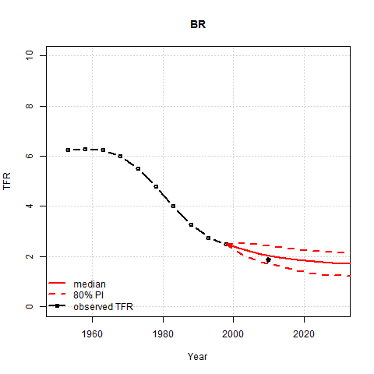
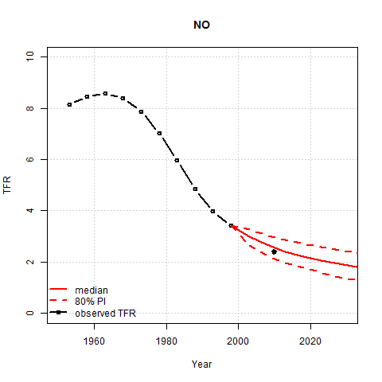
Out-of-Sample Prediction – Brazil (BR) and Region North (NO)

Slide 10
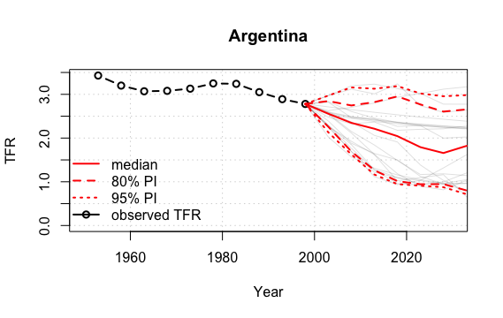
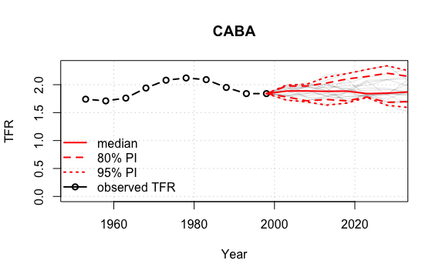
Out-of-Sample Prediction – Argentina (AR) and Region CABA

Slide 11
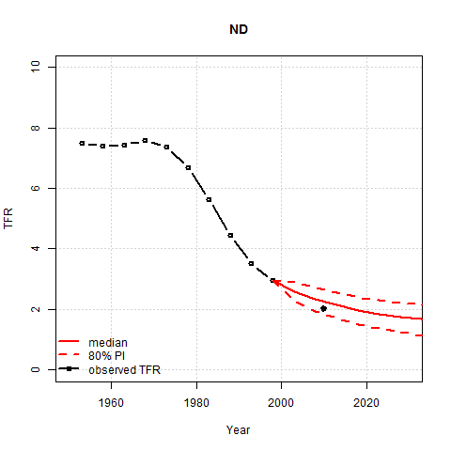
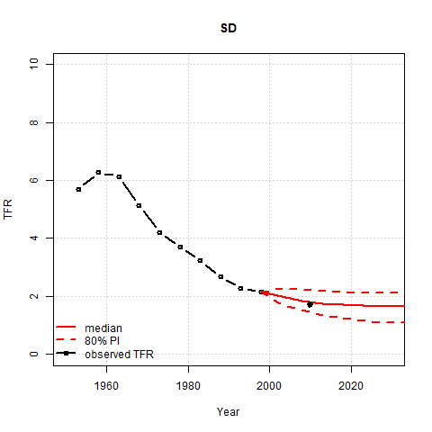
Out-of-Sample Prediction –Regions Northeast (ND) and Southeast (ND)

Slide 12
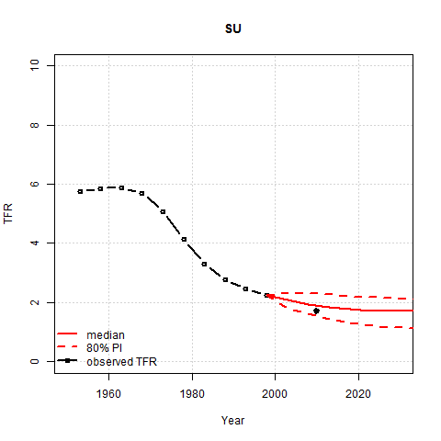
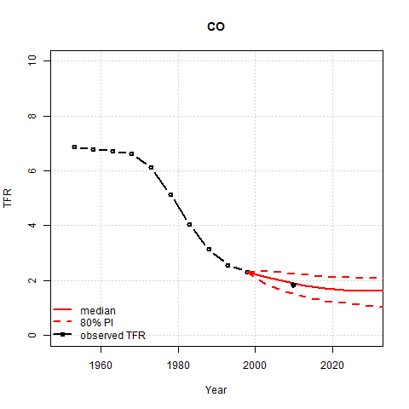
Out-of-Sample Prediction –Regions South (SU) and Central-West (CO)

Slide 13
Out-of-Sample Prediction – Units of Federation
Notes:
Differences between projected and observed fertility are not associated with either the fertility or the socioeconomic levels of the regions. It depends on the decrements in TFR according to the fertility level. The function that model the fertility implies decreasing decrements associated with lower levels of fertility, but most of the UFs actually accelerated the fertility decline in the last decade, reversing the historical trend. Even states who were already below the replacement-level presented a faster fertility decline.

Slide 14
Social advancements during the 2000s
Sharp decline in inequality and poverty
Acceleration of improvements in education
Infant mortality decline – IMR fell 40% in 10 years, from 29.0‰ in 2000 to 17.2‰ in 2010.
Notes:
Fertility differentials by income and education are still high, but have reduced in the last decade, since fertility has declined more among the less educated and poorer women (Berquó and Cavenaghi, 2014; IBGE, 2012). Cavenaghi and Berquó (2014) attribute some of the variations between groups to diversity in the behavior and access to contraceptive methods in the population, besides associate the changes in the income and education structure to the decline in fertility.

Slide 15
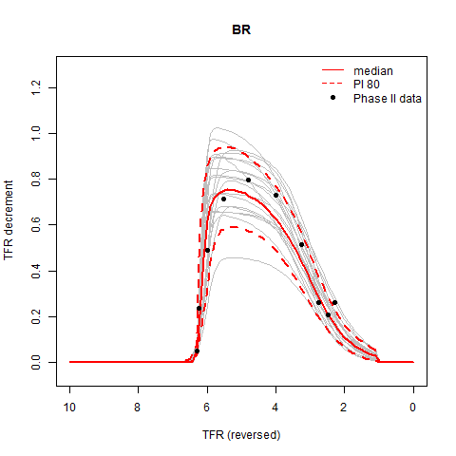
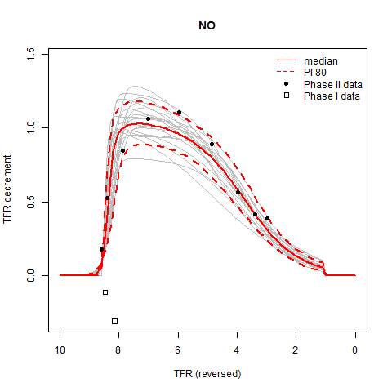
Population Projections: 2010-2030 – Brazil (BR) and Region North (NO)

Slide 16
Population Projections: 2010-2030 – Brazil (BR) and Region North (NO)

Slide 17
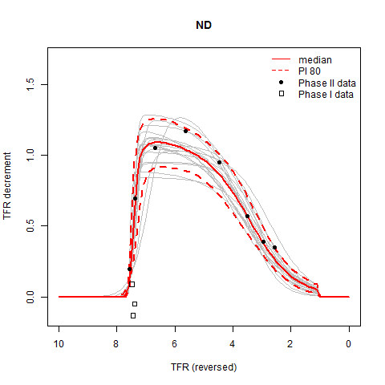
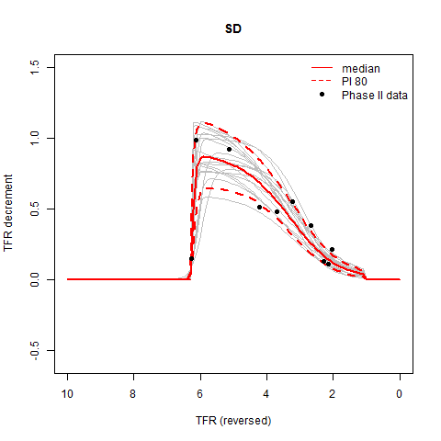
Population Projections: 2010-2030 – Regions Northeast (ND) and Southeast (ND)

Slide 18
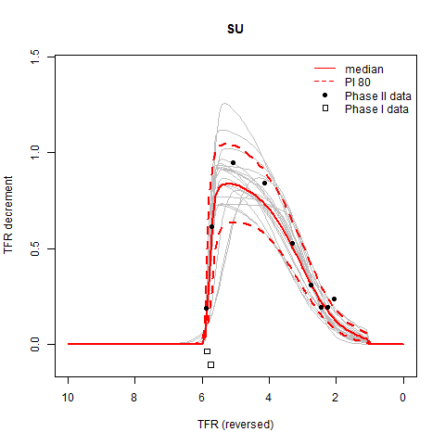
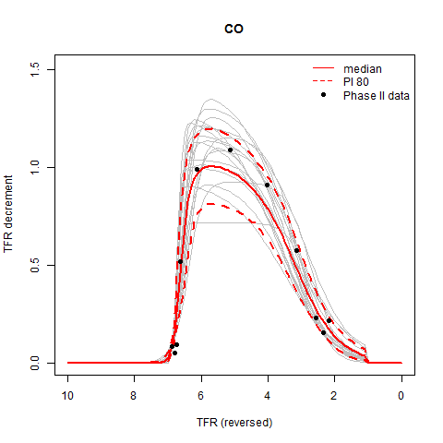
Population Projections: 2010-2030 – Regions South (SU) and Central-West (CO)

Slide 19
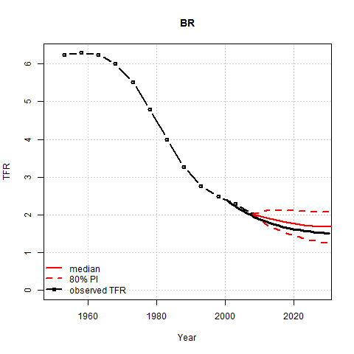
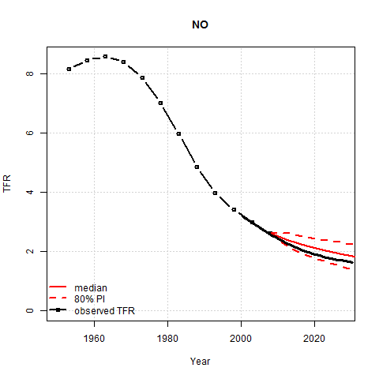
Population Projections: 2010-2030 – Brazil (BR) and Region North (NO)

Slide 20
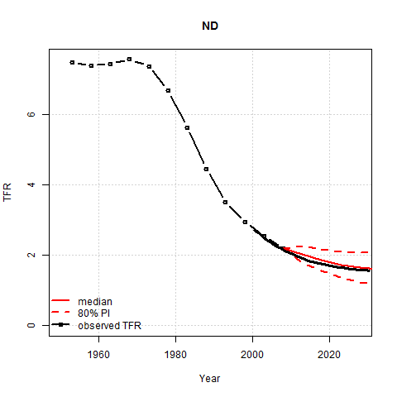
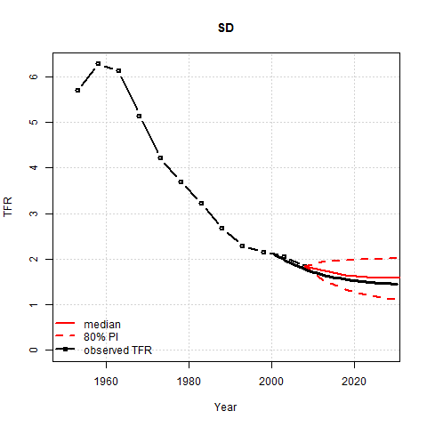
Population Projections: 2010-2030 – Regions Northeast (ND) and Southeast (ND)

Slide 21
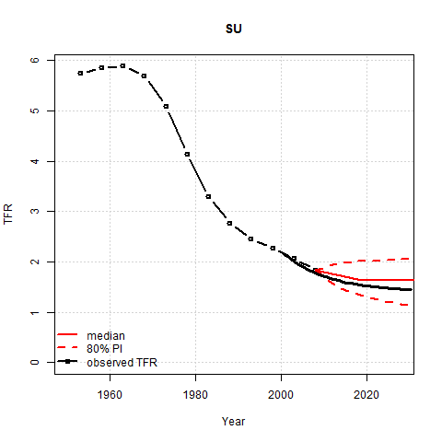
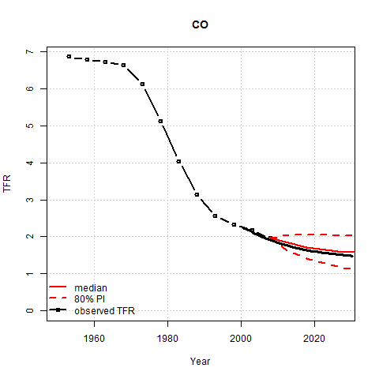
Population Projections: 2010-2030 – Regions South (SU) and Central-West (CO)

Slide 22
Population Projections: 2015 - 2030 UN Bayesian method and by IBGE - Units of Federation

Slide 23
Population Projections: 2015 - 2030 UN Bayesian method and by IBGE - Units of Federation

Slide 24
Population Projections: 2015 - 2030 UN Bayesian method and by IBGE - Units of Federation

Slide 25
Population Projections: 2015 - 2030 UN Bayesian method and by IBGE - Units of Federation

Slide 26
Total Fertility Rates projected by the UN Bayesian method (2030) and by IBGE (2030) and average household income (in R$) in 2010 – Units of Federation

Slide 27
Total Fertility Rates projected by the UN Bayesian method (2030) and by IBGE (2030) and average household income (in R$) in 2010 – Units of Federation

Slide 28
Discussion and Conclusions
Bayesian probabilistic approach offers a promising alternative to sub-national level projections in Brazil, providing less arbitrary point estimations and, most importantly, measures of uncertainty.
However, some adjustments might be added to the model, such as the incorporation of age-specific fertility rates and some covariates related to fertility, such as educational attainment.
Future works could try to use regions that have closer characteristics to the Brazilian context other than the level and the decrement of fertility decline in order to estimate the parameters.
Latin-American countries, which have more similar cultural and socioeconomic characteristics, in addition to a closer fertility age-structure, are potential candidates.

